Slide 1
Random() Adventures
in Minecrosoftcraft
A cautionary tale
Notes:
Intro
A cautionary tale of random number mistakes, in the world of Minecraft.

Slide 2

$
$
$
$
$
$
$
$
$
Notes:
In the world of Minecraft.
Popular and addictive game, written in Java. As common with games, not written with much regard to security.
Games worth serious money - Microsoft bought for $2.5b .

Slide 3
Pseudo-random number generators
rand(), Random(), ...
Java, C, C++ – LCG
Ruby, Python – Mersenne Twister
Notes:
Almost every language has a “default” built in random number generator. Can just be asked for random numbers.
There are more and less complicated random number generators, but few use CSPRNGs by default.
Still often a single numeric seed, often based on the system clock by default.

Slide 4
Would you trust a Random() stranger?
Notes:
Default random generators can be chosen to be as fast as possible by default or resist attacks by default – resistance makes them slower.
Sources of seed material limited, especially considering portability.

Slide 5
java.util.Random
state := (state * 25214903917) + 11 mod 2⁴⁸
100011110010111100111100110110101000001010001000
Notes:
Java's default random number generator. Are secure alternatives, but this is the simplest one seen in examples everywhere.
State is a single number. Each time we want an output, we do a simple multiply-add, and return the top 31 bits.
Because uses only a multiply, add is very fast, but not designed with security in mind.

Slide 6
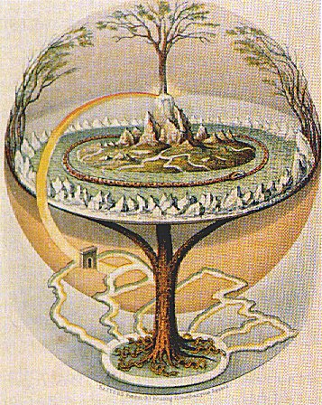
The world grows from a seed
Yggdrasil
Oluf Olufsen Bagge, 1847
Notes:
Infinitely large world, repeatably generated. Procedural generation techniques – Perlin noise, Voronoi Cells, etc.
Infinitely large procedural worlds, created repeatably from a 64 bit seed value. Each seed repeatedly produces the same pseudo-random result – same seed, same world.
In multiplayer worlds, seed is a secret – revealing it allows the world to be recreated, all resources found, etc.
We want those secrets

Slide 7
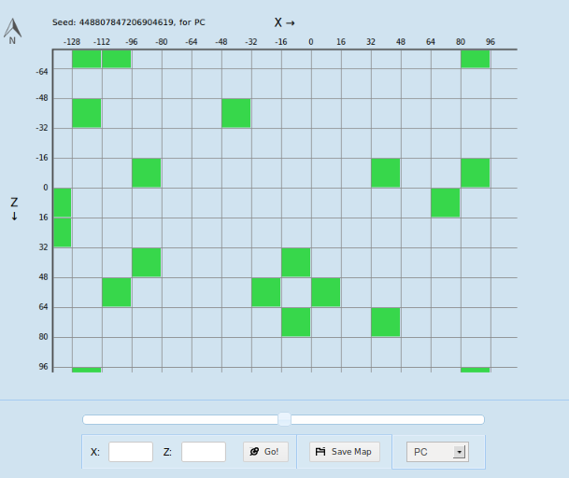

Slimes
© Mojang AB, CC-A-NC
chunkbase.com/apps/slime-finder/
Notes:
The world is full of hostile creatures. This particular one is called a slime. These creatures appear randomly in the world, deep underground.
The places where they can appear is decided by a randomly generated grid pattern. For any given seed, the pattern can be shown by tools like the one on the right here.

Slide 8
Random rnd = new Random(seed +
(long) (xPosition * xPosition * 0x4c1906) +
(long) (xPosition * 0x5ac0db) +
(long) (zPosition * zPosition) * 0x4307a7L +
(long) (zPosition * 0x5f24f) ^ 0x3ad8025f);
return rnd.nextInt() % 10 == 0;
Complicated looking, She'll be right.
Notes:
To make a reproducible yes/no decision with a 10% chance, combines the location and the world seed, then uses that as the seed to Random.
The red info is all constant for a cell in the grid. We can pre-compute this bit.

Slide 9
Collect known places where slimes appear
Search for seeds where they appear in those spots

Slide 10
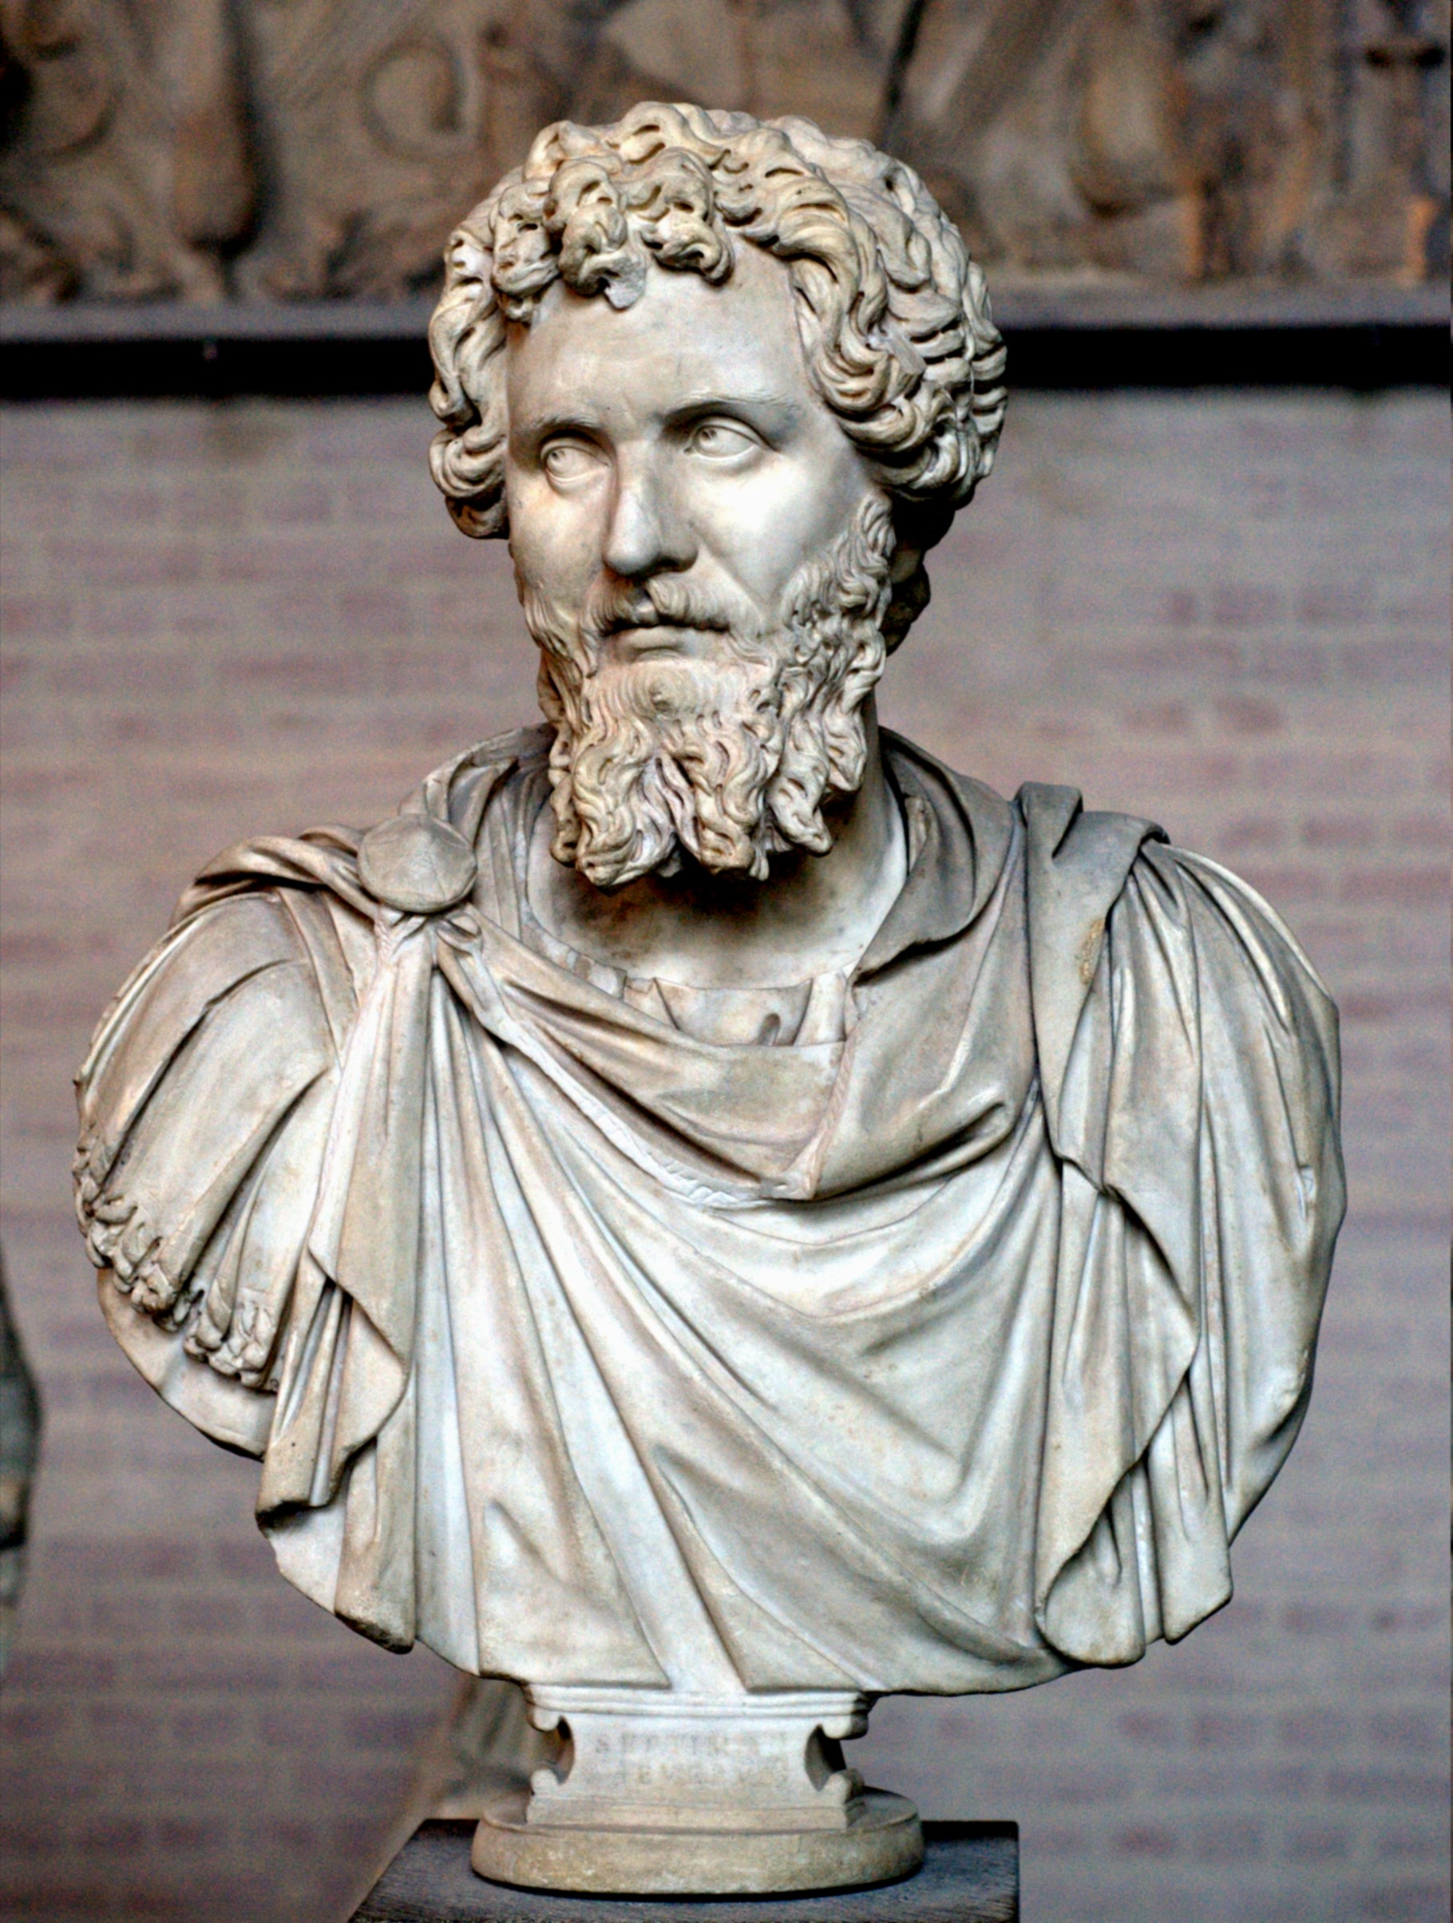
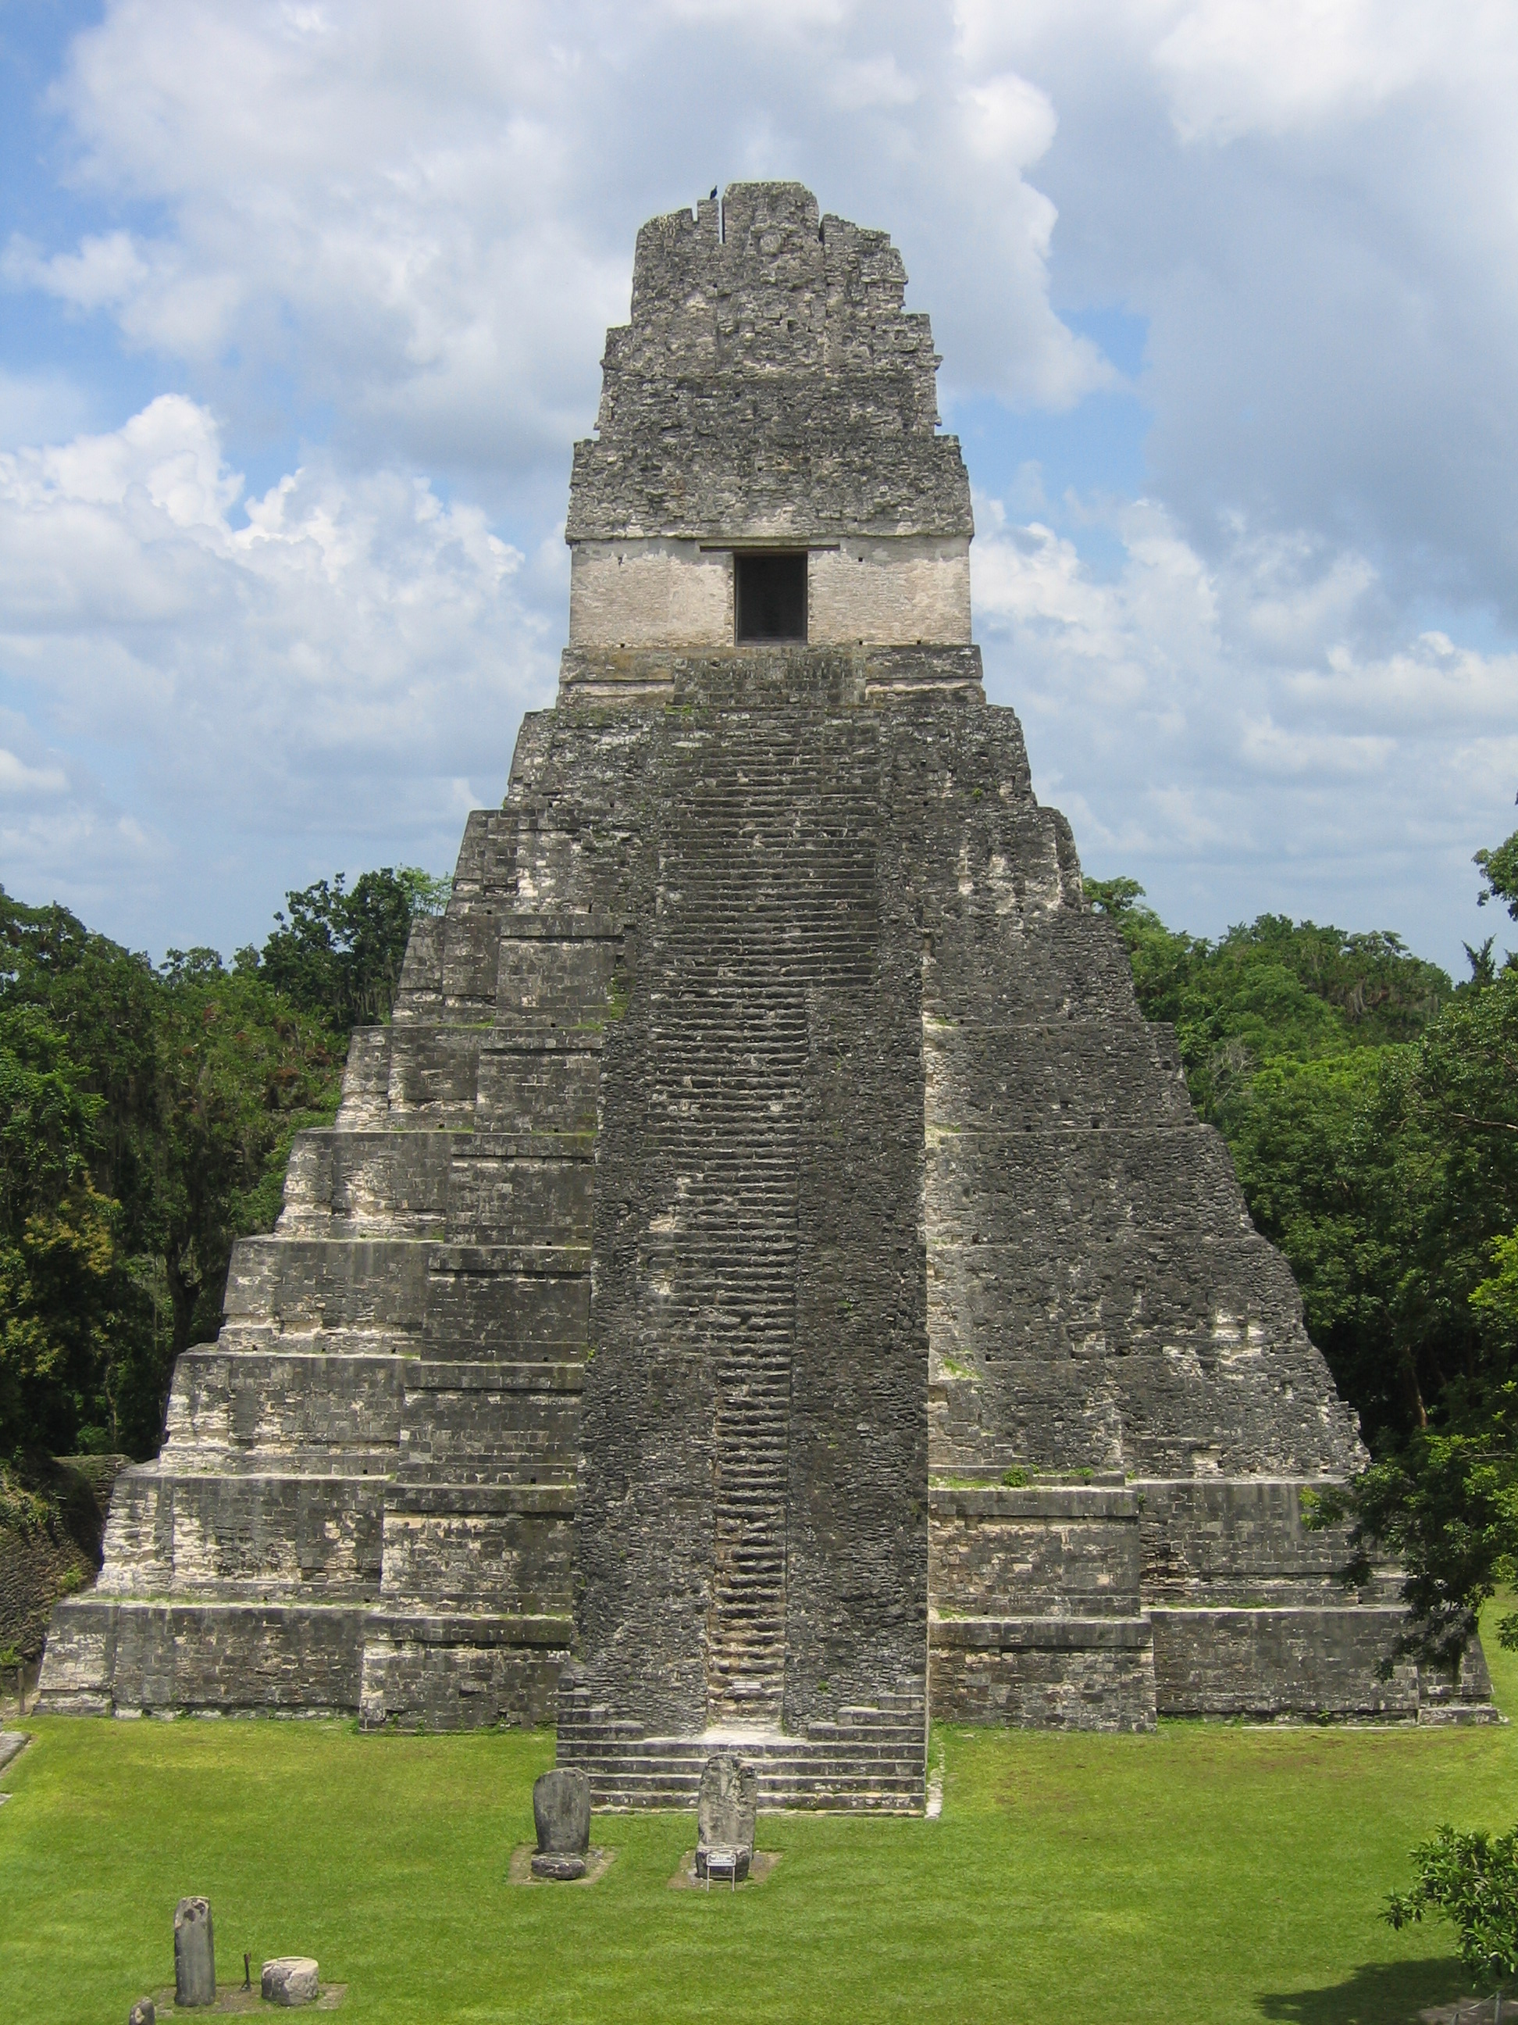
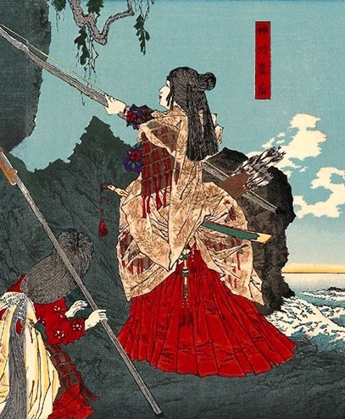
for (seed = 0; seed < (1 << 64); seed++) {
boolean match = true;
for (positionValue in knownAppearedPositions) {
Random rnd = new Random(seed + positionValue ^ 0x3ad8025f);
match = match && (rnd.nextInt() == 10);
}
if (match) ...
}
~ 1800 years
Septimius Severus
© Raymond Ostertag
CC-A-SA
Empress Jingū
Notes:
Naïve brute force of the seed.
1800 years ago Septimius Severus was the Roman emperor, the Mayan civilisation was just emerging, and the Japanese empress Jingū started a tradition of invading Korea.

Slide 11
java.util.Random
state := (state * 25214903917) + 11 mod 2⁴⁸
Notes:
Mod 2⁴⁸ means we only keep the lowest 48 bits, throw away the rest.
Accepts a 64 bit seed, but throws away the top 16. Can attack the bottom 48 independently of the top, like we're hanging with LanManager.

Slide 12
for (seed = 0; seed < (1 << 48); seed++) {
boolean match = true;
for (positionValue in knownAppearedPositions) {
Random rnd = new Random(seed + positionValue ^ 0x3ad8025f);
match = match && (rnd.nextInt() == 10);
}
if (match) ...
}
~ 10 days
Notes:
Only the lower 48 bits affect where slimes appear. We can attack the lower 48 bits by themselves, irrespective of the top 16..

Slide 13
32 + 65 = 97
132 + 765 = 897
1932 + 8765 = 10697
32 x 65 = 2080
132 x 765 = 100980
1932 x 8765 = 16933980
Notes:
LCGs are based on addition and multiplication.
In both of these we end up carrying values up places, but don't come down.
Same last 2 digits in = same last 2 digits out for both.

Slide 14
In LCGs we return the top bits of the state
Because the bottom bit does this:
0101010101010101
Notes:
This leads to a well known issue with the low bits of LCGs. Because we use addition and multiplication, no shifts down, the next value of the lowest bit is decided only by the previous value of the lowest bit.
Because there are 2 possible values, it has to repeat itself every two updates. The only full-period pattern is to alternate between odd and even states.
The next bit up is a bit better – can run in a cycle of 4. The ones up from that cycle every 8, 16, 32, etc.
This is why the top bits are used as the return value, not the bottom bits.

Slide 15
mod 2⁴⁸ mucks with decimal
2⁴⁸ = 281474976710656
Notes:
Messes with doing this in decimal as wrapping at 2⁴⁸ alters the lower bits.
Working in binary this isn't an issue – overflow doesn't change the lower binary bits.

Slide 16
All multiples of 10 are even
Notes:
Try relaxing our constraint that we need a multiple of ten for all position values, just look for now at all multiples of two.

Slide 17
11000010101110000001110010001100010101010101001
Notes:
Remember each time we use an LCG, we apply the state update then return the top bits of the state – 31 bits are requested in this case.
Whether the returned value is even or odd depends on a single bit of the state – the 31st most significant bit.
If odd, cannot be a multiple of 10.

Slide 18
11000010101110000001110010001100010101010101001
Notes:
This is the 18th least significant bit of the state, and is affected only by the lowest 18 bits (itself and lower) - red and black digits on the slide.
Whether the returned number is even or odd is decided by only 18 bits of state!
If this is a 1, the resulting number will be odd and cannot be a multiple of 10.

Slide 19
18 bits
~ 4 ms
Notes:
18 bits of state is about ¼ million possibilities. Can calculate a list and easily store a list of options in memory.
We can combine all our list of location values – the lower 18 bits of a seed have to produce an even result for all of them.
Use this to pre-filter a larger search, only look at the possible values for the lower 18 bits. With each observation we add, we halve the number of options we have to check.

Slide 20
Work out possibilities for lower 18 bits
Only look at 48-bit seeds which end with these

Slide 21
Narrowing down...
30 confirmed spots where slimes appear
… only one possibility for lower 18 bits
8 possibilities for lower 48 bits
~3 seconds to search possibilities
Notes:
Random pattern isn't actually entirely random – hard to get independent values.
Seed itself is usually generated by Random() - while 64 bits long only actually has 48 bits of entropy unless generated externally, entered manually.

Slide 22
random.nextLong()
48 bit state means only 2⁴⁸ outputs
Only actually 2⁴⁸ possible “random” seeds.
9 likely seeds
Notes:
In the multiplayer server, 64 bit seeds are generated from a 48-bit generator by default.
For any given 48-bit suffix, on average only one 64 bit seed is possible.

Slide 23
random.nextLong()
48 bit state means only 2⁴⁸ outputs
Only actually 2⁴⁸ possible “random” seeds.
9 likely seeds
Notes:
In the multiplayer server, 64 bit seeds are generated from a 48-bit generator by default.
For any given 48-bit suffix, on average only one 64 bit seed is possible.

Slide 24
Don't trust a Random() stranger
Even if they give you a free ride
https://github.com/pruby/slime-seed
Notes:
Don't trust a Random() stranger for security-sensitive applications. We need both a good source of entropy, and good processing for any serious applications.
You don't need to leak much information before people can launch an attack. In this case yes/maybe statements only.
Use cryptographically secure random number generators when any secret value is used as an input.

